Slide 1
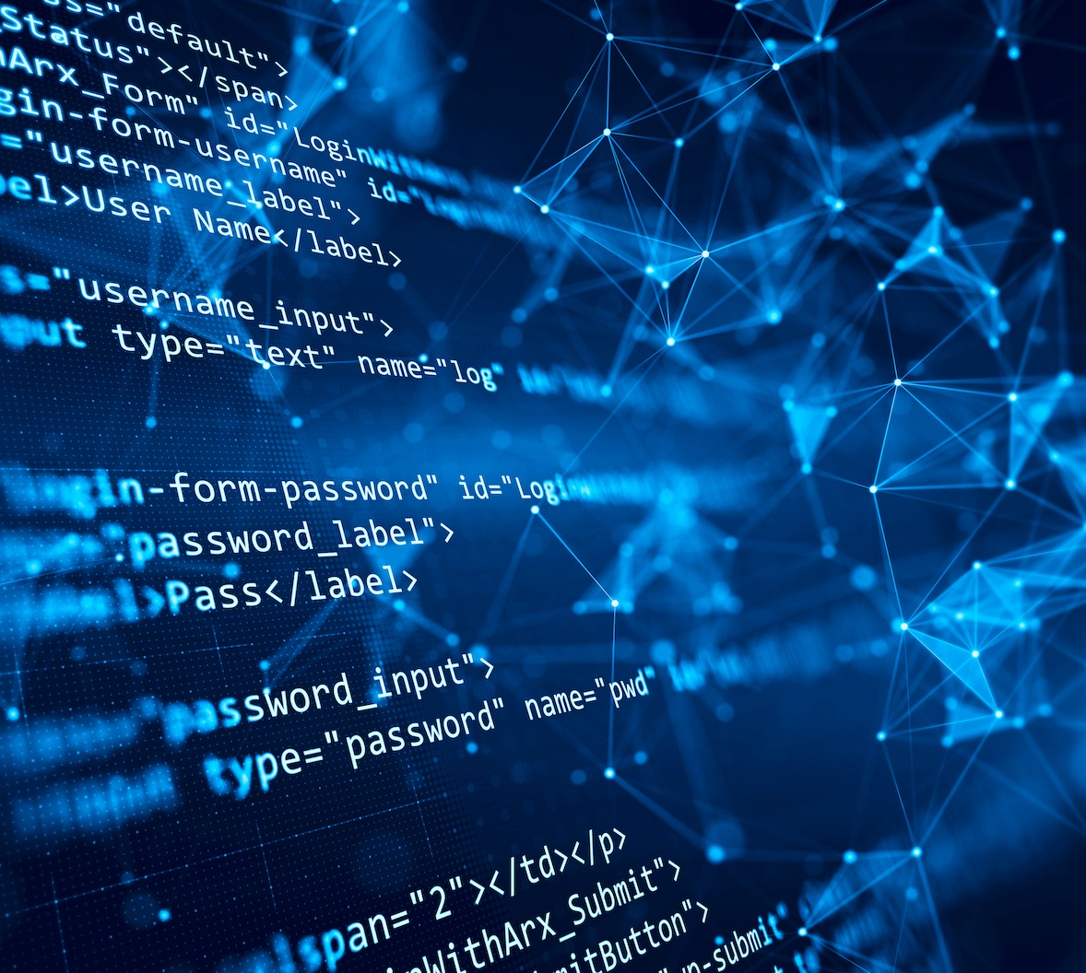

Team 55: Research Lab
Inventory Tracker
Bi-Weekly Update 4 Lizzett Tapia
Sumedha Bhattacharyaa
Jonathan Moore
Evan Ross TA: Niloofar Borzooei
Notes:
Michelle

Slide 2
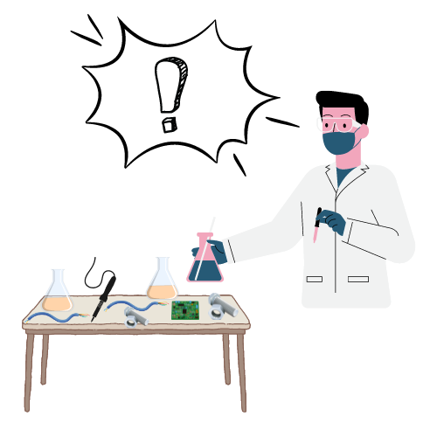
Problem Statement
“The current lab inventory tracking systems at Texas A&M are inefficient, and it is necessary to create new, organized software to increase the overall performance and efficiency of the Lab.”

Slide 3
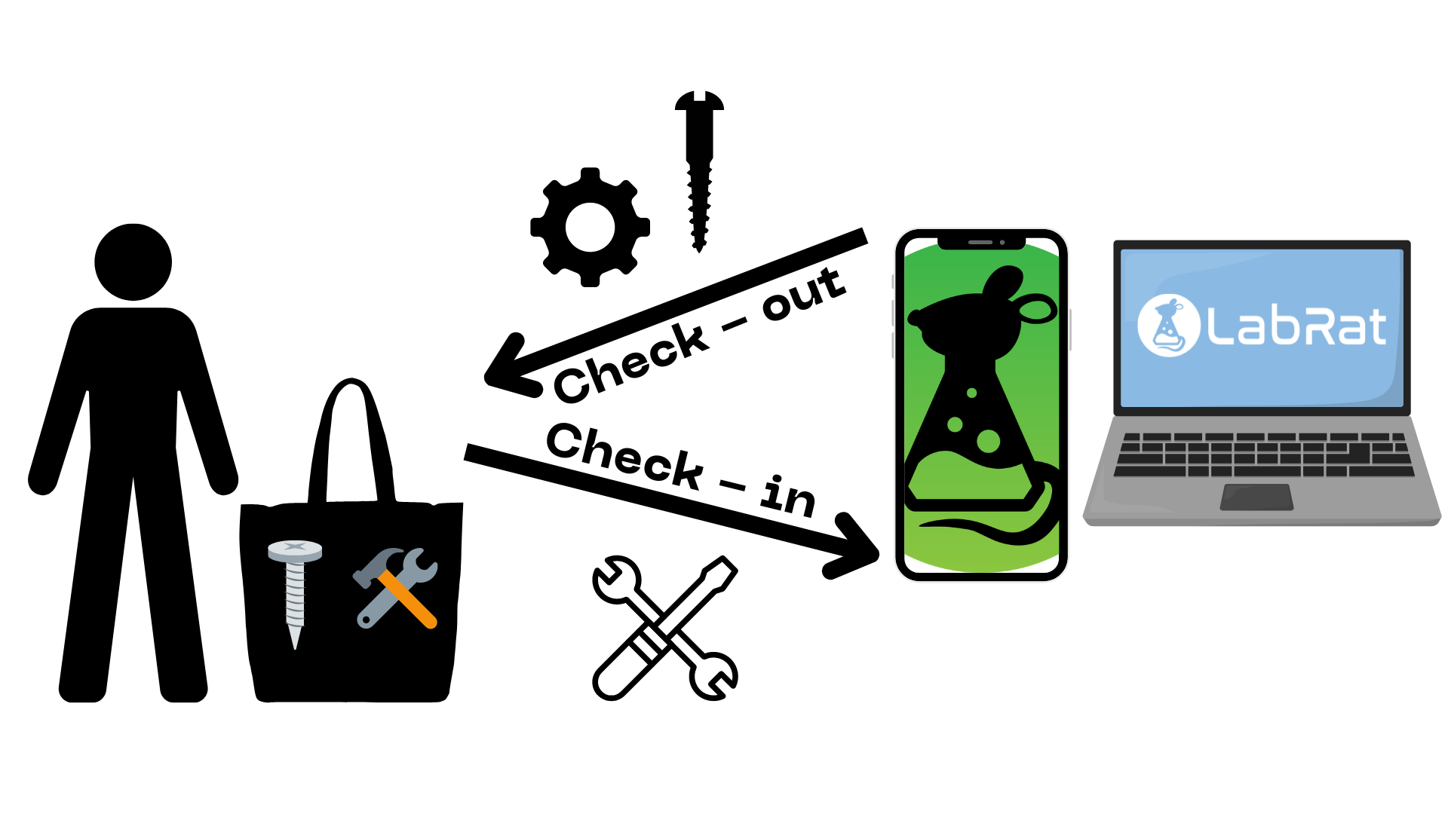
Solution Proposal
“Develop a web and mobile application integrated with a database to streamline inventory management in TAMU labs. The mobile app uses a machine learning-based image classification system to allow users to easily check items in and out by scanning them.”

Slide 4
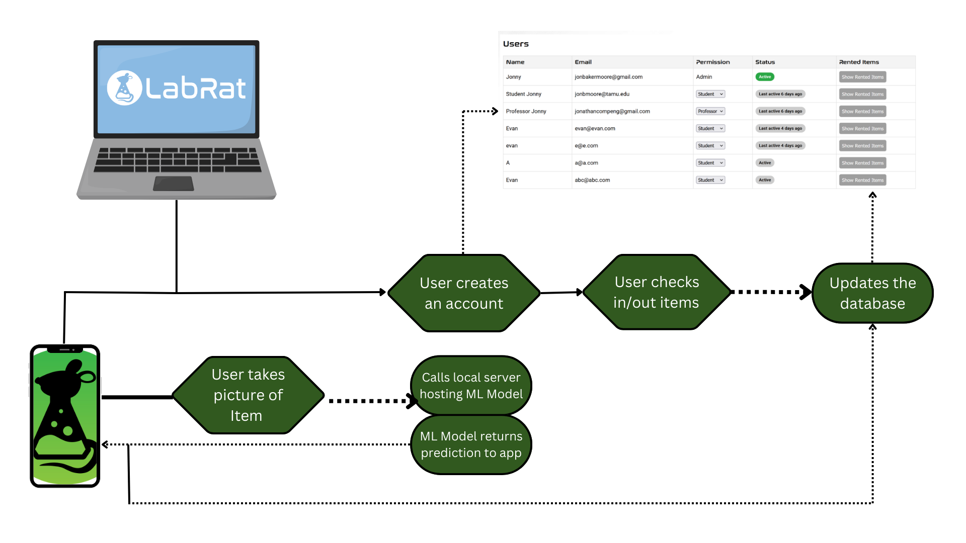
Integrated System Diagram
Notes:
Eric

Slide 5
Project Timeline
Subsystem Designs and Testing (completed 1/27) | Integration preparation of server with website and mobile app (completed 2/3) | Integration of ML model with mobile application (to complete by 2/27) | Final Integration (to complete by 3/3) | System Tests (to complete by 3/24) | Validation (to complete by 4/14) | Demo and Report (to complete by 4/21 and 4/28 respectively)

Slide 6
Android App
Accomplishments since last update 15 hrs of effort | Ongoing progress/problems and plans until the next presentation
Fully integrated with machine learning Uses machine learning output to direct users | Test Machine learning functionality and accuracy Test functionality with database Improve UI

Slide 7
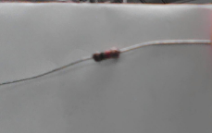
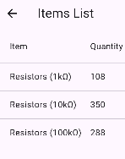
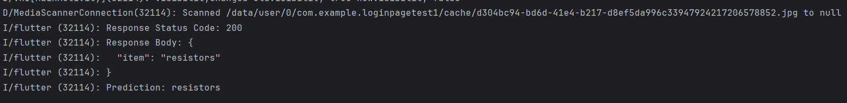
Android App

Slide 8
Machine Learning Model
Accomplishments since last update 11 hrs of effort | Ongoing progress/problems and plans until the next presentation
Completed Integration with Local Server (that hosts the ML Model) with the Mobile App Verified that images are stored for debugging | Ongoing testing of accuracy for resistors and capacitors

Slide 9
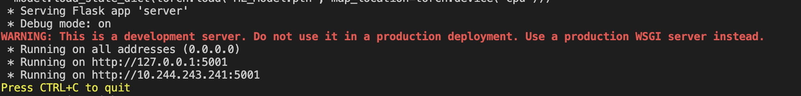
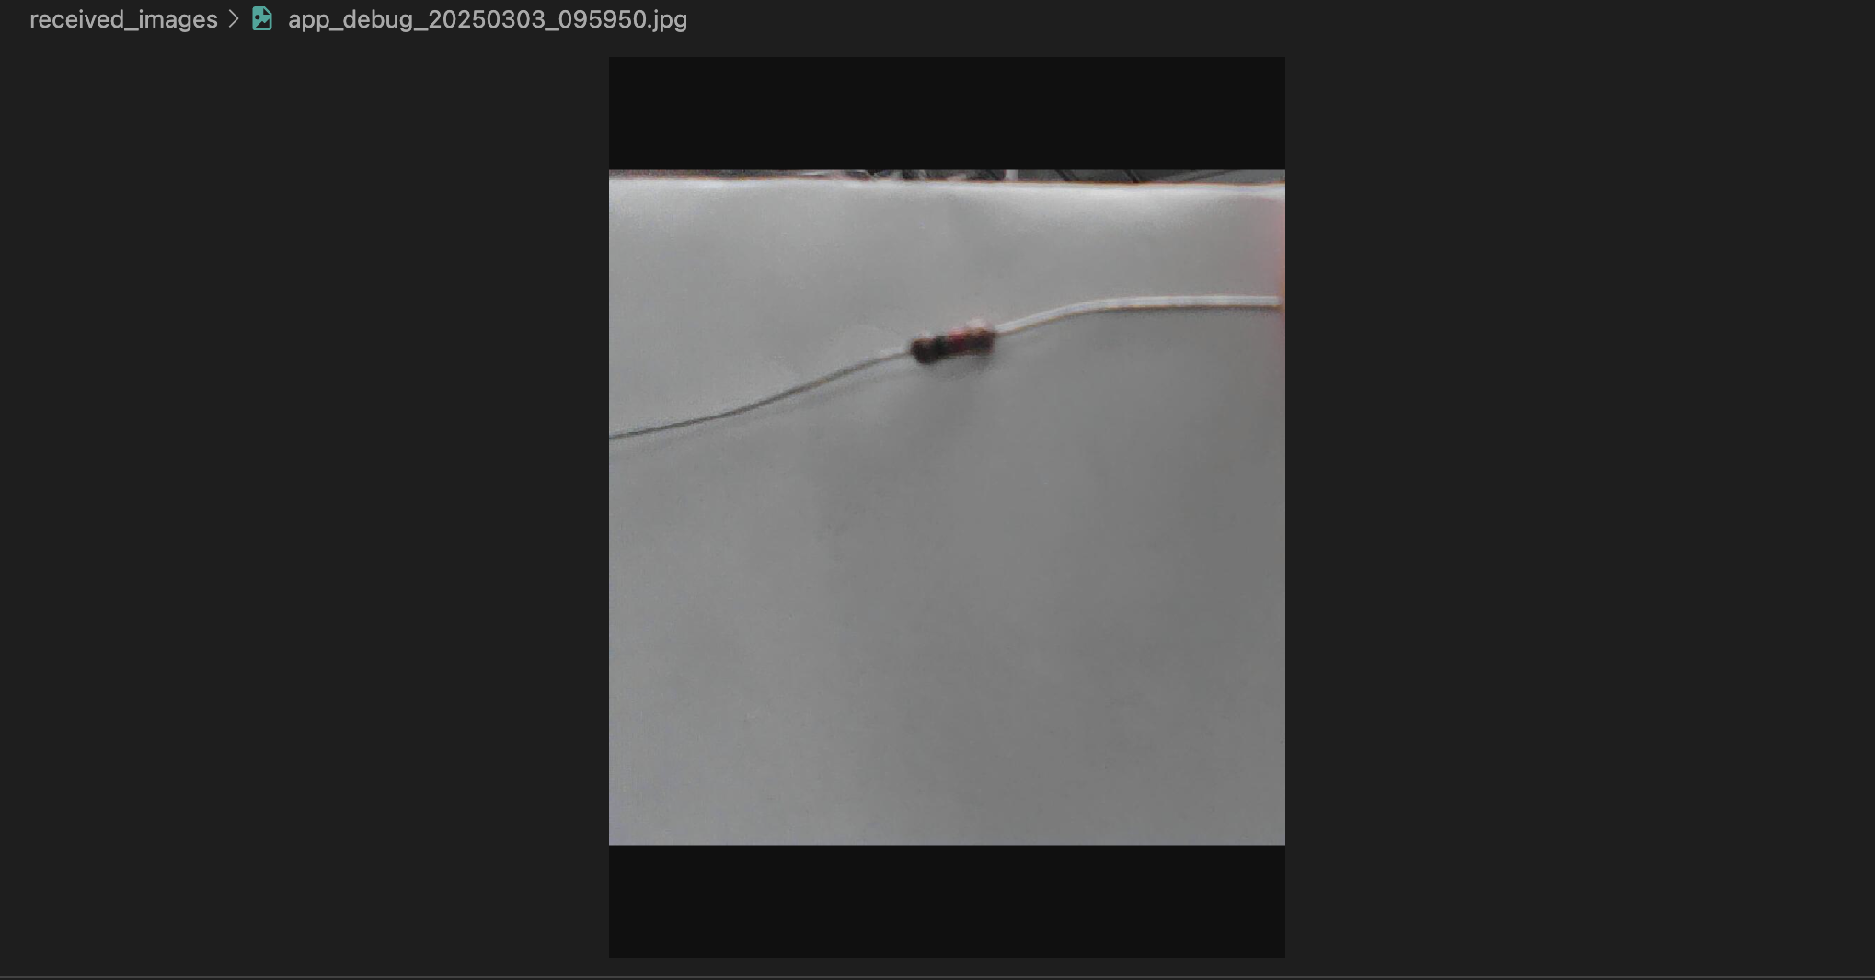
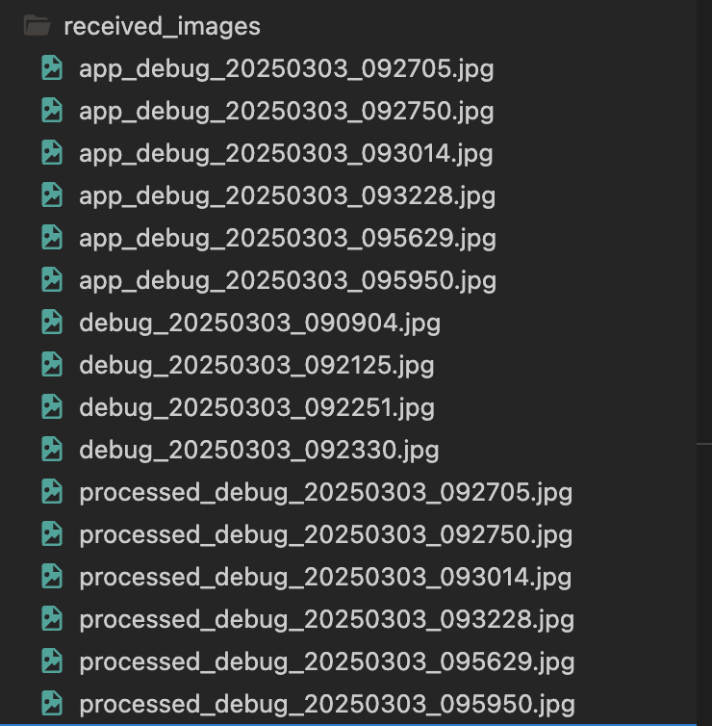
Machine Learning Model

Slide 10
Database Server
Accomplishments since last update 11 hrs of effort | Ongoing progress/problems and plans until the next presentation
Fully integrated with website and mobile app Completed data consistency validation between the server and website | Continue running more validation tests between the mobile app Work through validation plan and complete majority

Slide 11
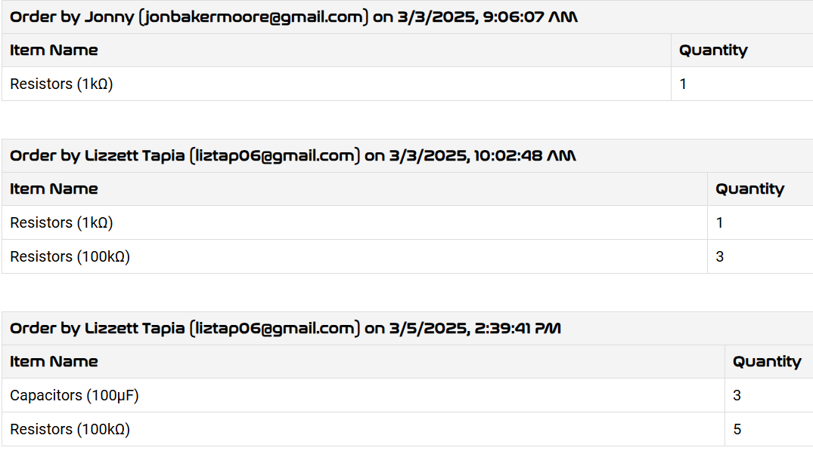
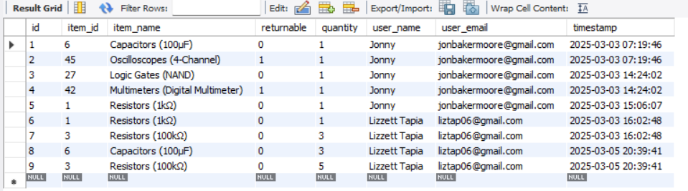
Database Server

Slide 12
Website
Accomplishments since last update 13 hrs of effort | Ongoing progress/problems and plans until the next presentation
Fully-complete integration; ready for validation. Validated certain tests. | Continuing validation plan.

Slide 13
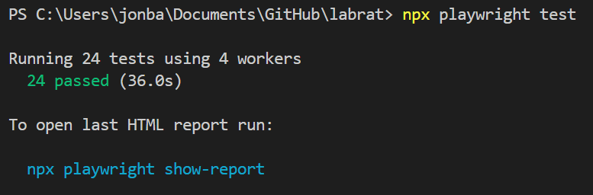
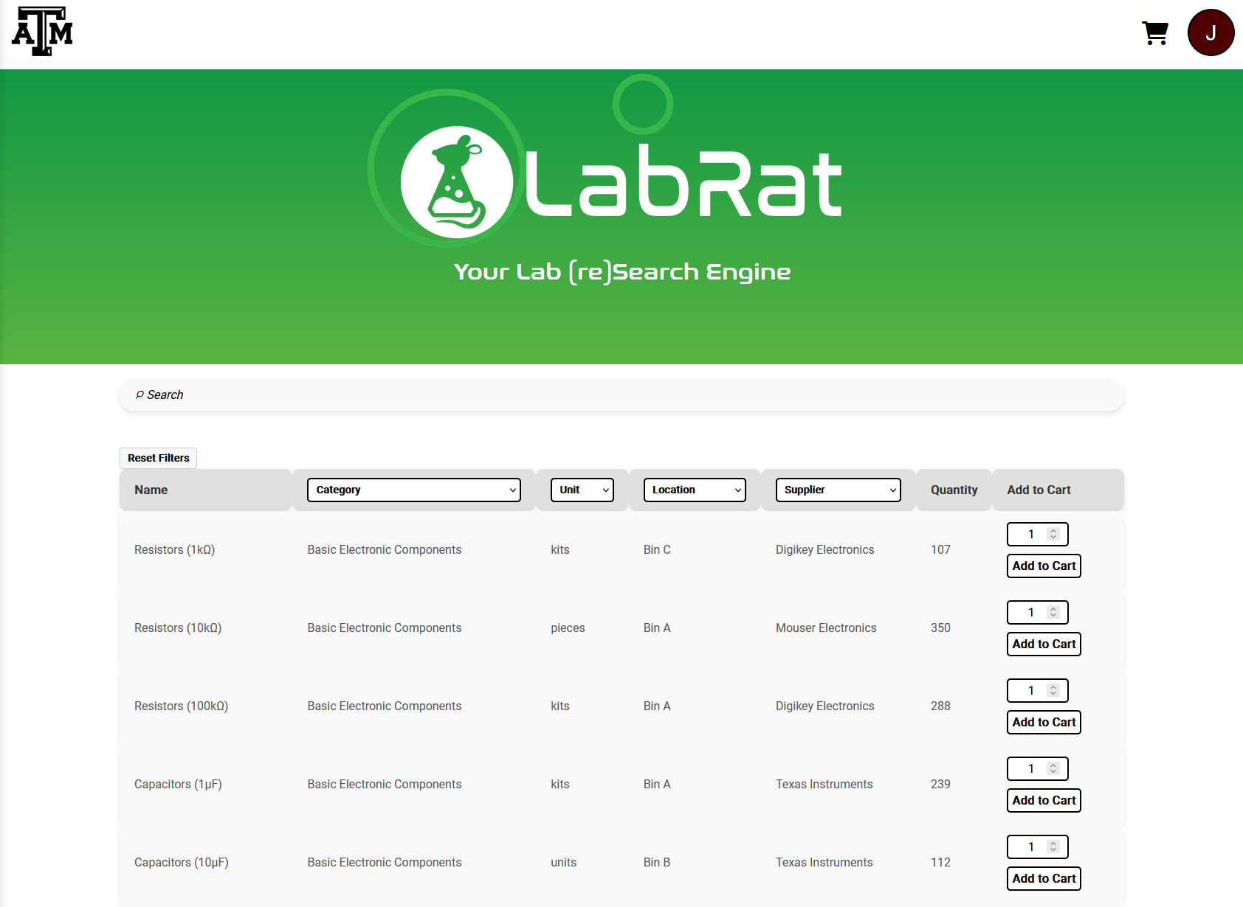
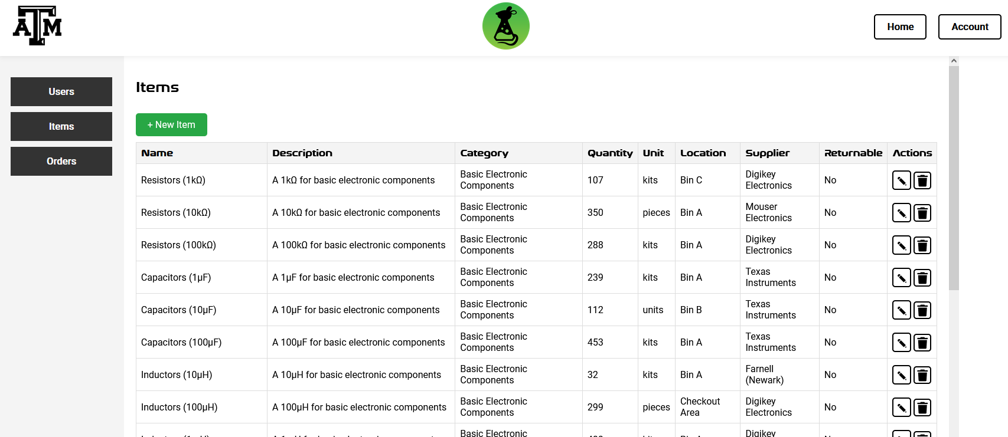
Website

Slide 14
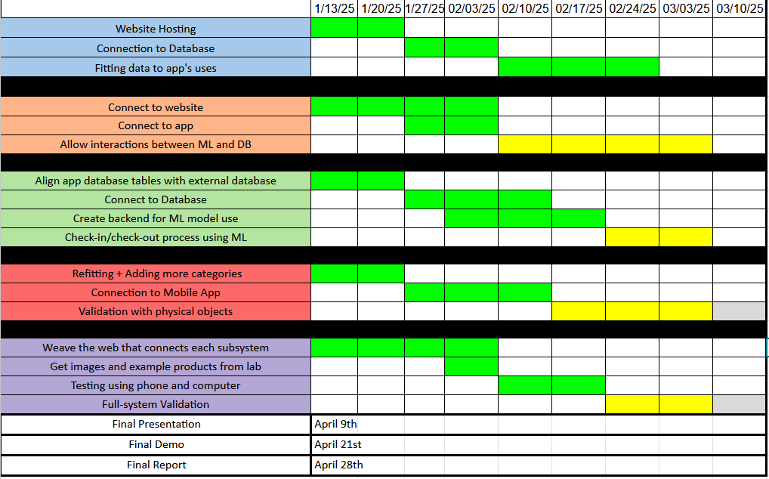
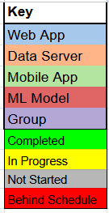
Execution Plan
Notes:
Michelle

Slide 15
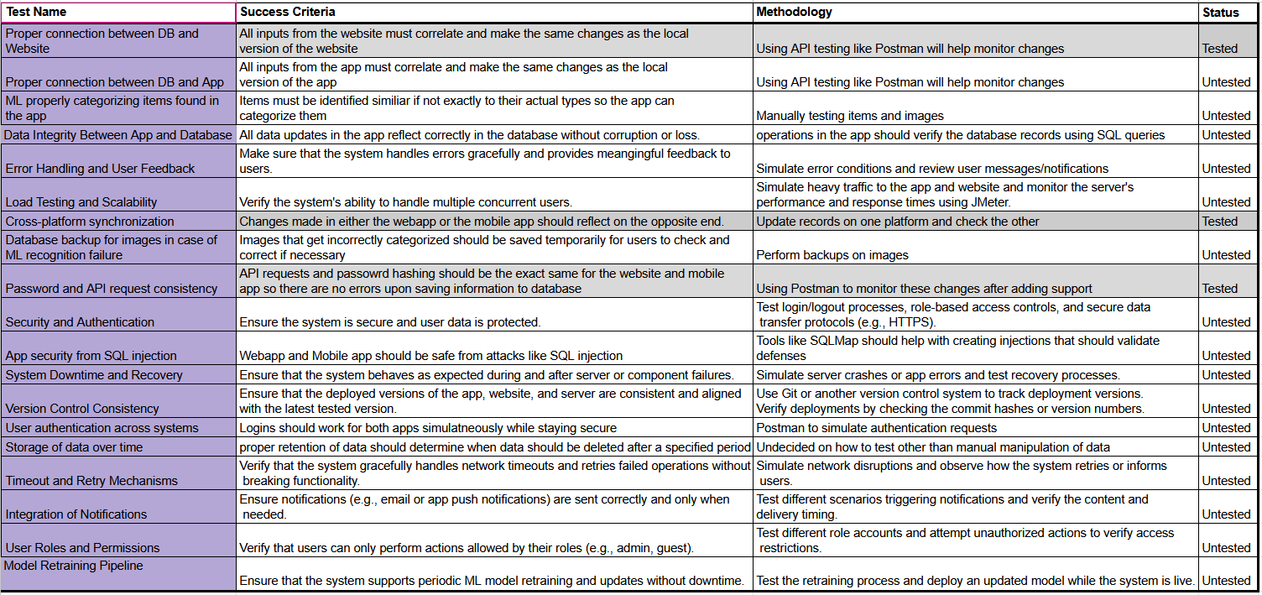
Validation Plan
Notes:
Michelle

Slide 16
Thank You For Listening!
Notes:
Michelle

